Slide 1
SAFE HARBOR

Slide 2
Built in 2003, Safe Harbor Safe Housing offers: Ten comfortable two- and three-bedroom furnished apartments in a secured building; Classes covering key topics, such as parenting, money management, self-esteem, and assertiveness; Children's services, including educational and support groups and tutoring, legal assistance with the protective order or stalking injunction process; case management that helps residents create a personal development plan and connects them to a network of area service providers for: medical care, child care, resume writing, food, job training, job placement, Interview skills, utility bill subsidization.

Slide 3
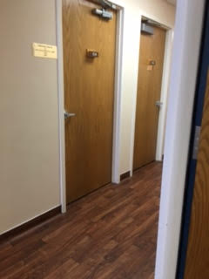

Slide 4
Safe Harbor Crisis Center Shelter provides essential support and safety for domestic violence survivors and their children who need a safe place to stay. Many people think that a domestic violence shelter is like a homeless shelter, but that is not the case. The shelter is a safe place offering a personal, home-like space for safety and healing. The shelter was designed to feel like home combining safety and comfort with private rooms, kitchen, laundry room, and outdoor playground.

Slide 5
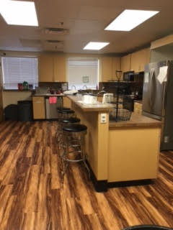

Slide 6
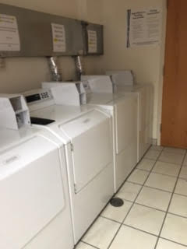

Slide 7
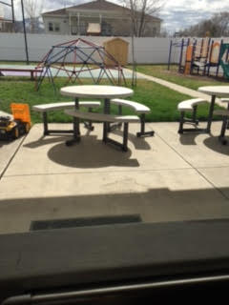
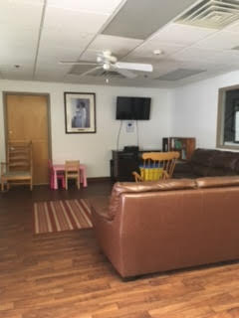

Slide 8
